Slide 1
Module 5: Global Climate Change

Slide 2
Background

Slide 3
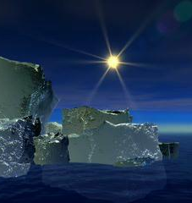
What controls the Earth’s temperature?
Amount of energy received by the sun
Reflection vs absorption of sun’s energy (albedo)
The amount of energy retained by the earth’s atmosphere.

Slide 4
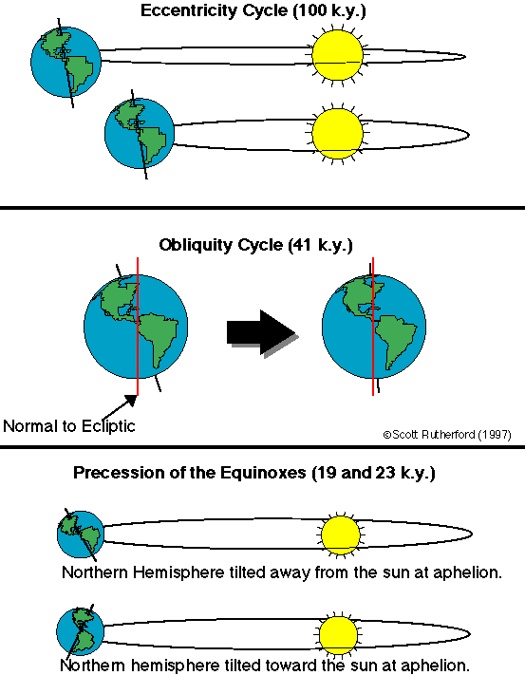
Solar irradiance: position relative to the sun (Milankovitch cycles)
The path of the earth around the sun and the angle of the earth vary at different time scales.
Has been important influence for glacial periods (every 100,000 years) over the past 500,000 years.
Notes:
http://channel.nationalgeographic.com/channel/videos/ice-age-cycles/

Slide 5
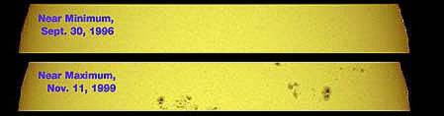
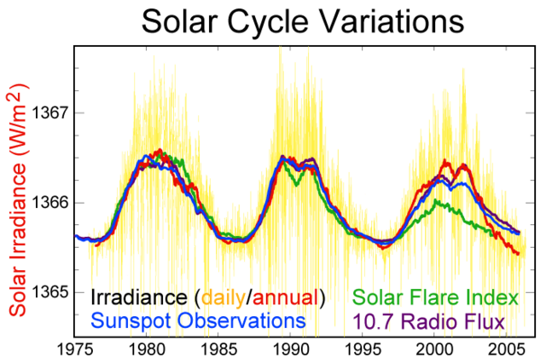
Solar irradiance: Sunspot cycles
Sunspots – reflect magnetic activity of sun, and sun’s brightness.
Approximately an 11 year cycle (9-13)
Maunder minimum coincides with the Little Ice Age.
Notes:
http://star.arm.ac.uk/climate/intro.html
http://earth.usc.edu/~geol150/evolution/lastmillenia.html

Slide 6
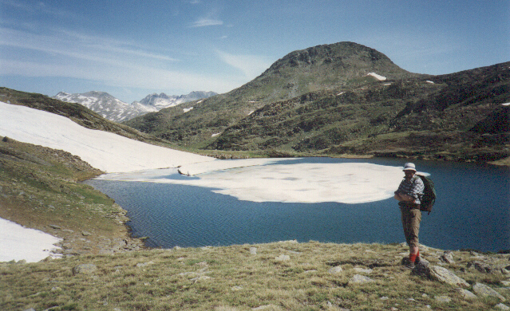
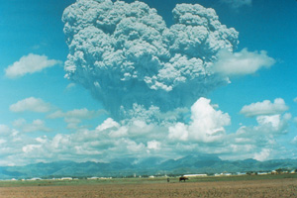
Reflection of energy
Albedo (reflectivity)
Lighter things reflect more light energy
Darker things absorb more light energy (heat)
(Creates positive feedback)
Aerosols lead to increased reflection of solar radiation.
Volcanic activity → cooling.
Notes:
http://earthobservatory.nasa.gov/Newsroom/NasaNews/2002/200207099816.html

Slide 7
Atmospheric composition
Gasses in the atmosphere influence temperature
Diagram the greenhouse effect

Slide 8
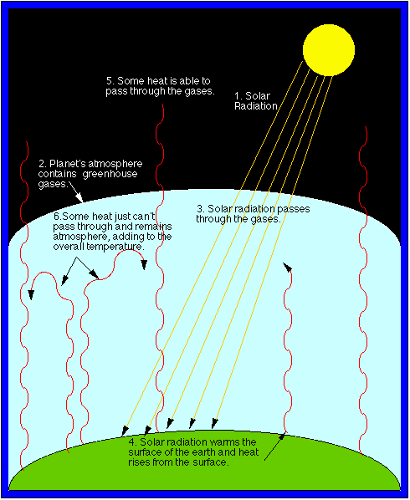
How global warming works
The greenhouse effect: Energy is retained.
Gases in the atmosphere trap heat.
CO₂
CH₄
NO_{x}s
CFCs

Slide 9
How do we know this global temperature?
Hansen et al. 2010 from Goddard Institute for Space Studies, NASA
http://pubs.giss.nasa.gov/docs/2010/2010_Hansen_etal_1.pdf
Compiled different datasets from weather stations all over the world.
Used a model to interpolate (smooth) data for land
Use bucket (ships) and satellite measurements calibrated with ship measurements for the ocean

Slide 10
Question 1: Is this global temperature changing over time? Is earth ‘warming’? If so, at what rate?
How do we determine if something is changing? The easiest way is to look at average trend over time. We apply a mathematical relationship to look at trends over time.

Slide 11
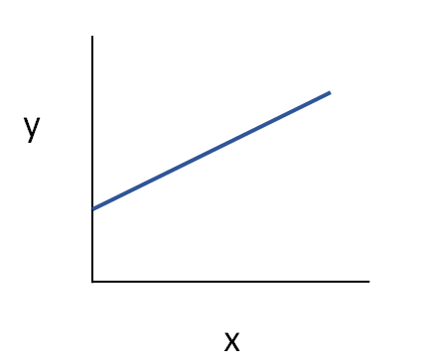
Linear regression overview
y = b + m*x
m
b
Notes:
Tell students how to read the graphs they will be generating. Recall from high school introductory algebra that:
x = the independent variable, which is in this first data set time (years)
y = the dependent variable, which is in this case average global temperature (ºC)
m = the slope of the line (ºC/year), which indicates the relationship between the two variables
b = the average global temperature in the year that we begin our analysis

Slide 12
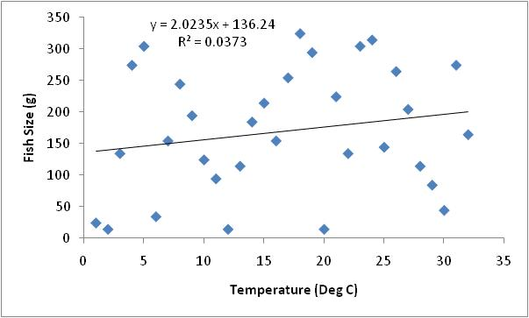
Linear regression overview
r²=proportion of variation explained
R²~0
0% of variability explained

Slide 13
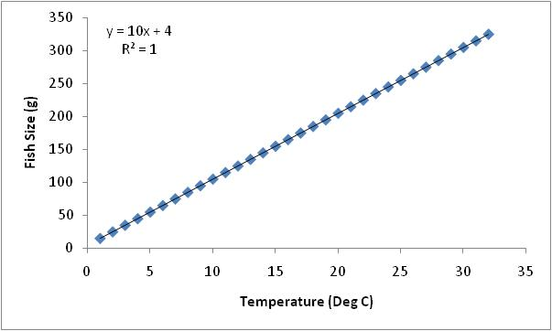
Linear regression overview
r²=proportion of variation explained
R²~1
100% of variability explained,
perfect line

Slide 14
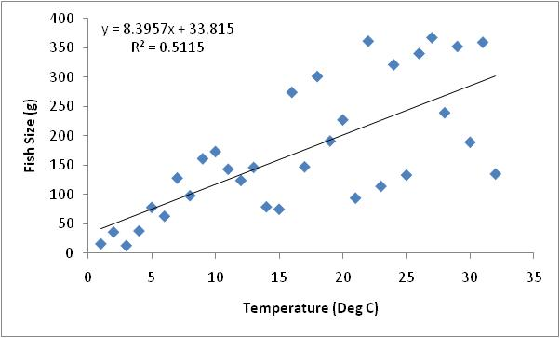
Linear regression overview
r²=proportion of variation explained
R²>0.3
30% of variability explained,
Possible predictor but other drivers are playing a role

Slide 15
Question 1: Is this global temperature changing over time? Is earth ‘warming’? If so, at what rate?
Step 1: graph the global average temperature found in your dataset and create a linear model to determine the rate of change.
Be careful with units for rate!

Slide 16
Question 2: What might be causing this change in global average temperature?
What are the options?

Slide 17
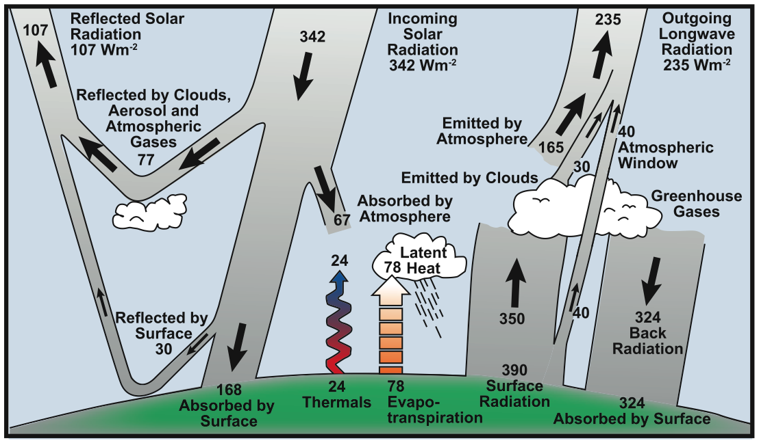
Greenhouse gases play a role!

Slide 18
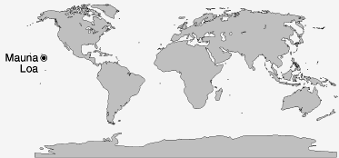
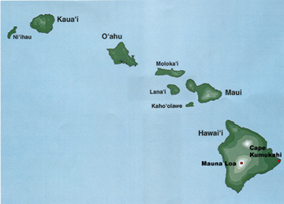
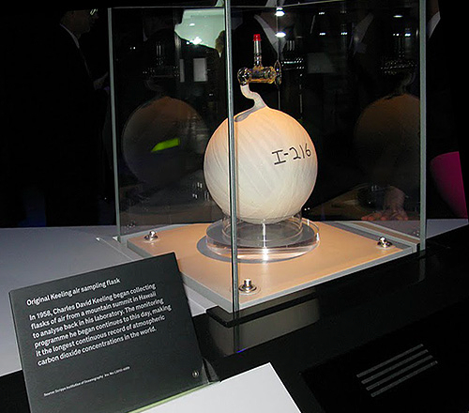
Mauna Loa CO₂ dataset
Dr. Dave Keeling started measuring the CO2 concentration in air in 1958
Collected air in vacuum cleared glass flasks and measured CO2 content (masking tape holds the glass in case of implosion)
Still measured with the method today (as well as sensors)
Original flask at Science Museum in London

Slide 19
Question 2: What might be causing this change in global average temperature?
Step 1: Graph the Mauna Loa CO₂ concentration dataset.

Slide 20
Question 3: How are temperature and CO₂ related?
Step 2
: Graph temperature and CO₂ concentrations over the same time period.

Slide 21
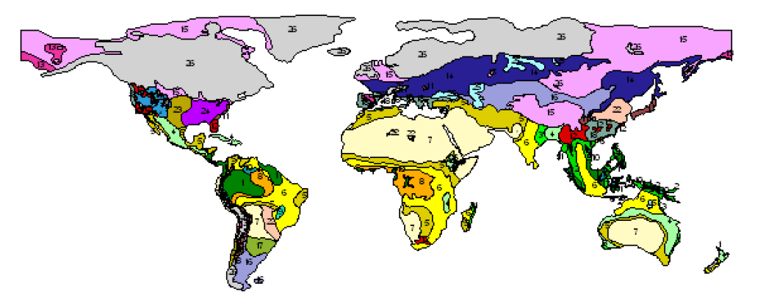
But this is only recent history…
The earth is 4.54 billion years old
The last ice age was 110,000 to 12,000 years ago with peak glaciation 22,000 years ago
The world looked different!
Northern USA and Canada covered by ice (grey)
Southern US covered by taiga (coniferous forest) and grassland
Southern Europe was tundra
Ray and Adams 2001

Slide 22
Question 4: How can we compare the recent data to geologic history?

Slide 23
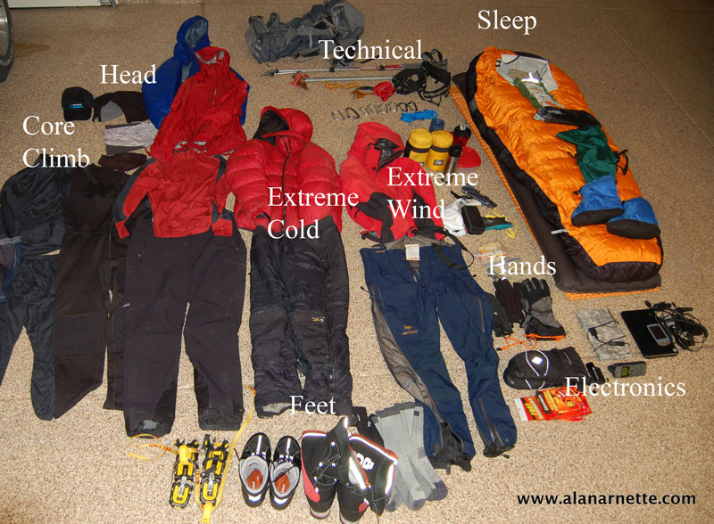
You’re off on a trip . . .

Slide 24
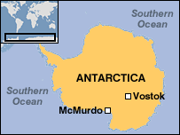
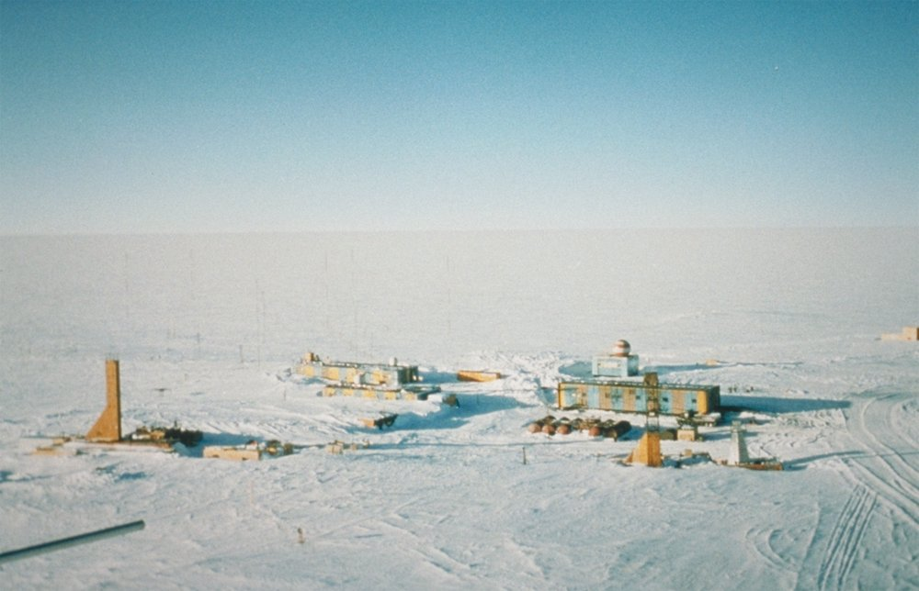
Vostok, Antarctica
Also go to Google Maps, see the single image there.

Slide 25
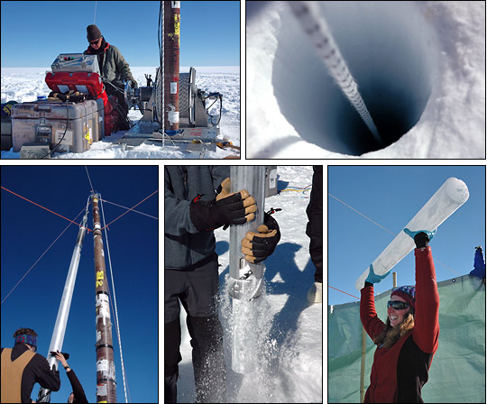
Steps in taking an ice core

Slide 26
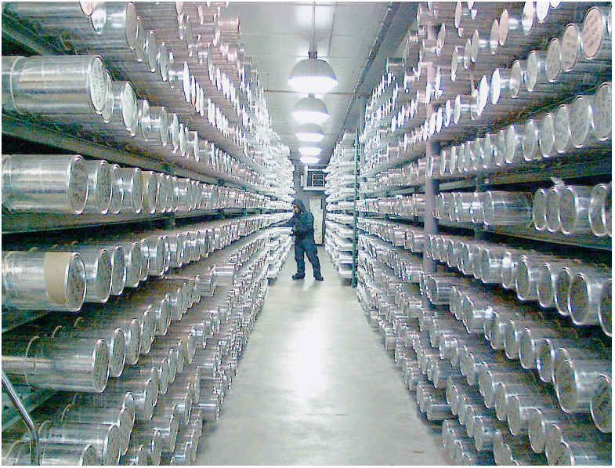
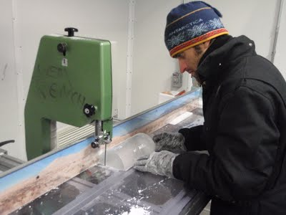
Core processing

Slide 27
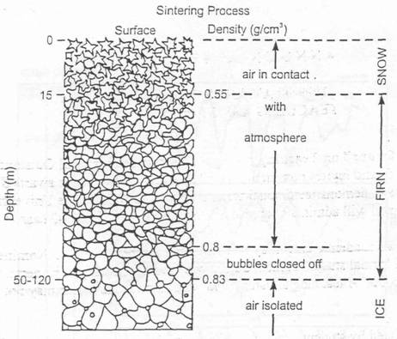
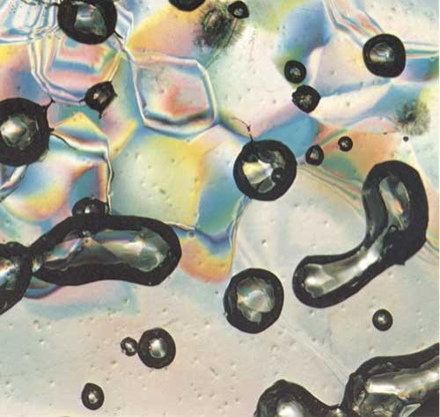
Air bubbles contain gas
Air bubbles trapped in the ice represent atmospheric chemistry.
Notes:
http://www.globalchange.umich.edu/globalchange1/current/labs/Lab10_Vostok/Vostok.htm

Slide 28
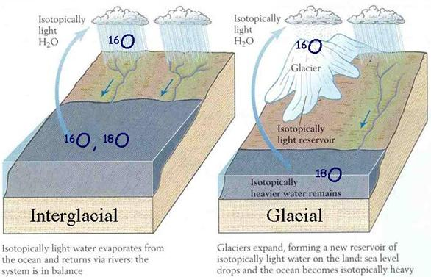
Air temperature determined by water chemistry (oxygen isotope example)
The isotope ratios in the ice water reflect the climate’s temperature
Notes:
http://www.globalchange.umich.edu/globalchange1/current/labs/Lab10_Vostok/Vostok.htm
Evaporation preferentially includes the lighter isotope

Slide 29
Question 4: How can we compare the recent data to geologic history?
Step 3: What is the maximum rate of change in the ice core record?
How do the data compare to current conditions in Antarctica?
Find the fastest rate of change in the ice core data – graph the data first and then pull out a time with the fastest change:
Vostok air temperature
Vostok atmospheric CO₂
How do the pre-historic rates of change compare to current rates of change?

Slide 30
How do we know that recent changes are due to human activity?
Temperature are higher than they have been in the last 500,000 years.
Changes in atmospheric composition correspond with industrial development.
The current rate of temperature change is greater than anything we have seen in the geologic record.
Models suggest that we could not achieve current temperatures unless human activity is considered.

Slide 31
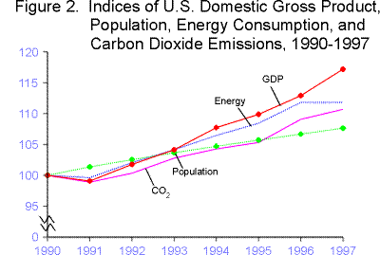
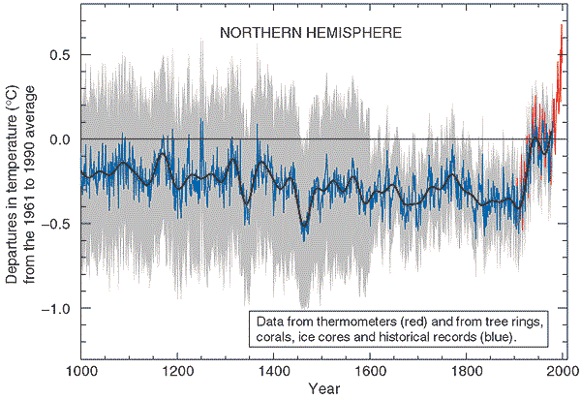
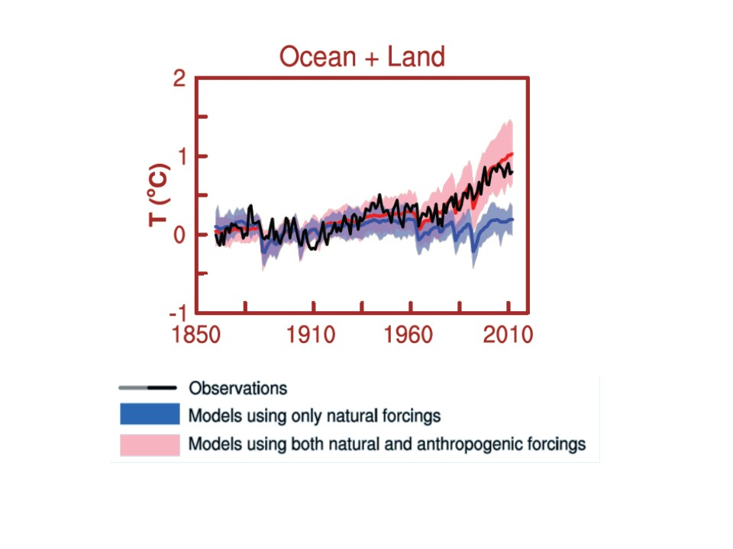
1. Correlations
2. Rates of change
Increases in greenhouse gases.
Changes are relatively recent (past 200 years).
Rates of change are rapid.
CO₂ concentrations exceed that natural range over the past 650,000 years.
Since the early 1800’s, CO₂ concentrations have risen from 280 to 379 parts per million…
3. Models
IPCC 2014

Slide 32




Project EDDIE: Climate Change
O’Reilly, C.M., D.C. Richardson, and R.D. Gougis. 15 March 2017. Project EDDIE: Climate Change. Project EDDIE Module 8, Version 1.
Module development was supported by NSF DEB 1245707.

Slide 33
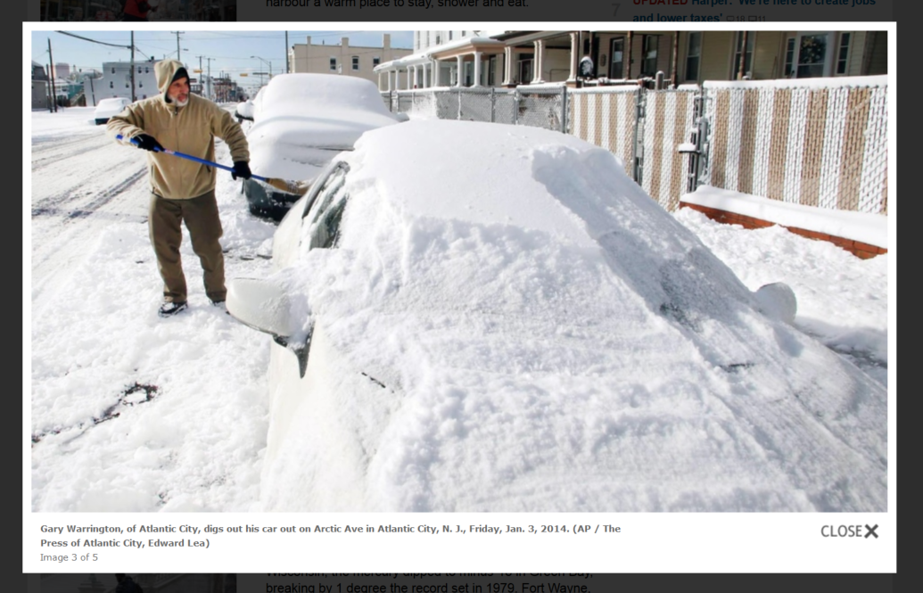
Does one really big snow storm indicate that the climate is getting colder?
Arctic Avenue, Atlantic City, NJ
Jan 2014
http://www.ctvnews.ca/world/deadly-storm-lashes-u-s-northeast-1-900-flights-grounded-1.1616156

Slide 34
The extreme weather, with temperatures reaching -20°F with wind chill and 2 feet of snow reinforces doubts that global warming is caused by humans.
Do you believe this statement? Why or why not?

Slide 35
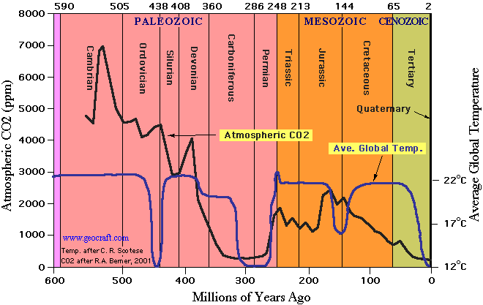
Past temperatures on earth
Barrett (2003)
Notes:
http://mysite.verizon.net/mhieb/WVFossils/Carboniferous_climate.html

